Slide 1
A Brief Introduction to HTML5

Slide 2
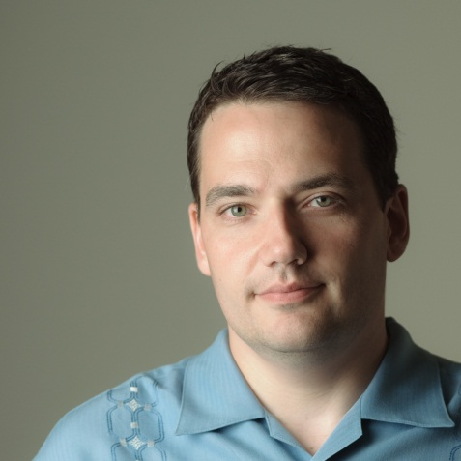
Bio
Rob Larsen
Rob Larsen has more than 12 years’ experience as a front end engineer and team leader, building web sites and applications for some of the world’s biggest brands. He’s currently Senior Specialist, Platform, at Sapient Global Markets.
Rob is an active writer and speaker on web technology with a special focus on emerging standards like HTML5, CSS3 and the ongoing evolution of JavaScript. He’s written one book, Professional jQuery (WROX), and is hard at work on Beginning HTML and CSS (WROX.)
Rob is also active in the open source community with contributions to multiple projects and long-term contributions to to HTML5 Boilerplate. An @h5bp organization member.
rob@htmlcssjavascript.com
http://htmlcssjavascript.com/
@robreact on twitter
www.linkedin.com/in/robreact
Notes:
2

Slide 3
Introducing Sapient
Düsseldorf
Chicago
Amsterdam
Münich
Toronto
Stockholm
Kansas City
Calgary
North America
Denver
London
Moscow
Noida
San Francisco
New Delhi
Boston
Zürich
Shanghai
New York
Europe
Asia
Los Angeles
Washington
Atlanta
Dubai
Miami
Geneva
Bangalore
Houston
Singapore
South America
Australia
Brisbane
Sydney
Melbourne
Market cap
10,000+
Founded in
1991
as of June 2012
$1.51bn
employees
On NASDAQ
Global
3 business units
2,000
1996
Sapient Global Markets
Sapient Nitro
Sapient Government Services
Since
client base
Notes:
Introduction to SGM
Overview slide - map w/ offices
Positioning statement
NOTES: try and turn the map into a spinning globe….have the offices blink as they go by on the globe
3

Slide 4
In the Beginning, There Was HMTL

Slide 5
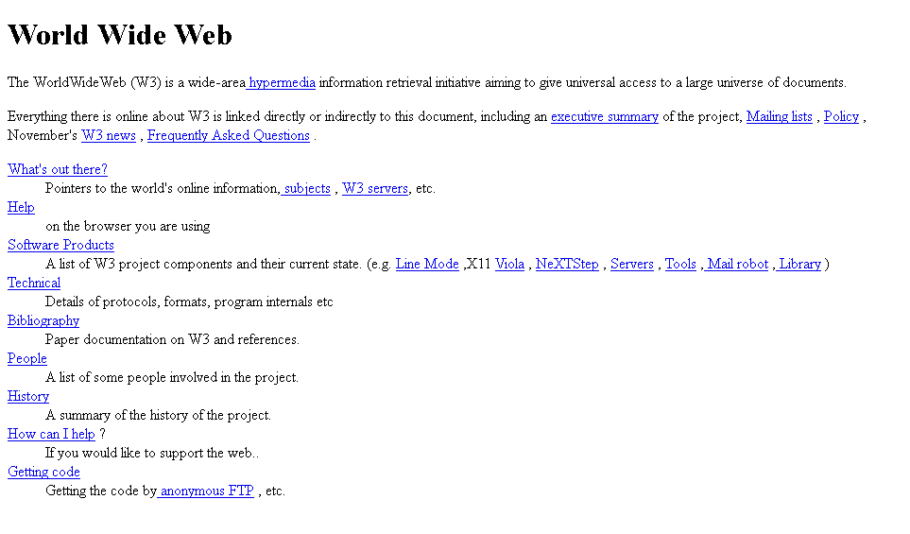
And it didn’t do much.
Notes:
5

Slide 6
Just so you know, HTML stands for…
HyperText Markup Language
Now you know.
The important part of that is HyperText.
That basically means links
The ability to link documents to other documents was the web’s first killer feature.

Slide 7
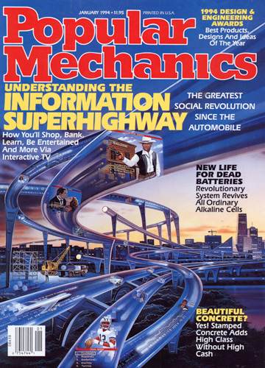
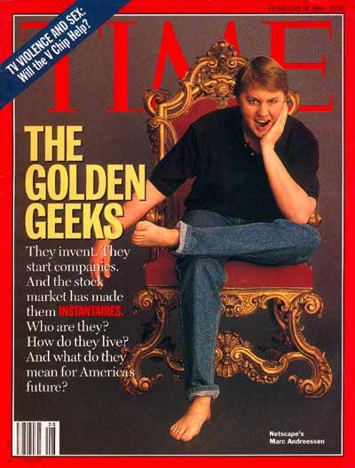
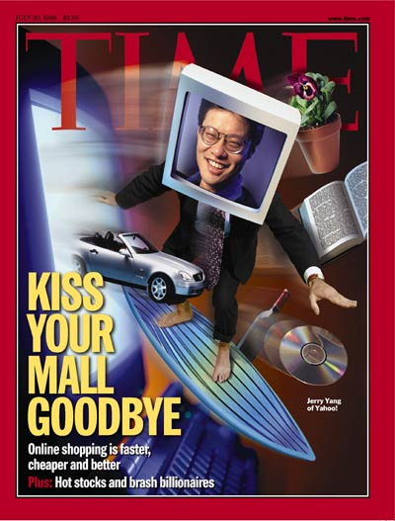
Still… it took off.

Slide 8
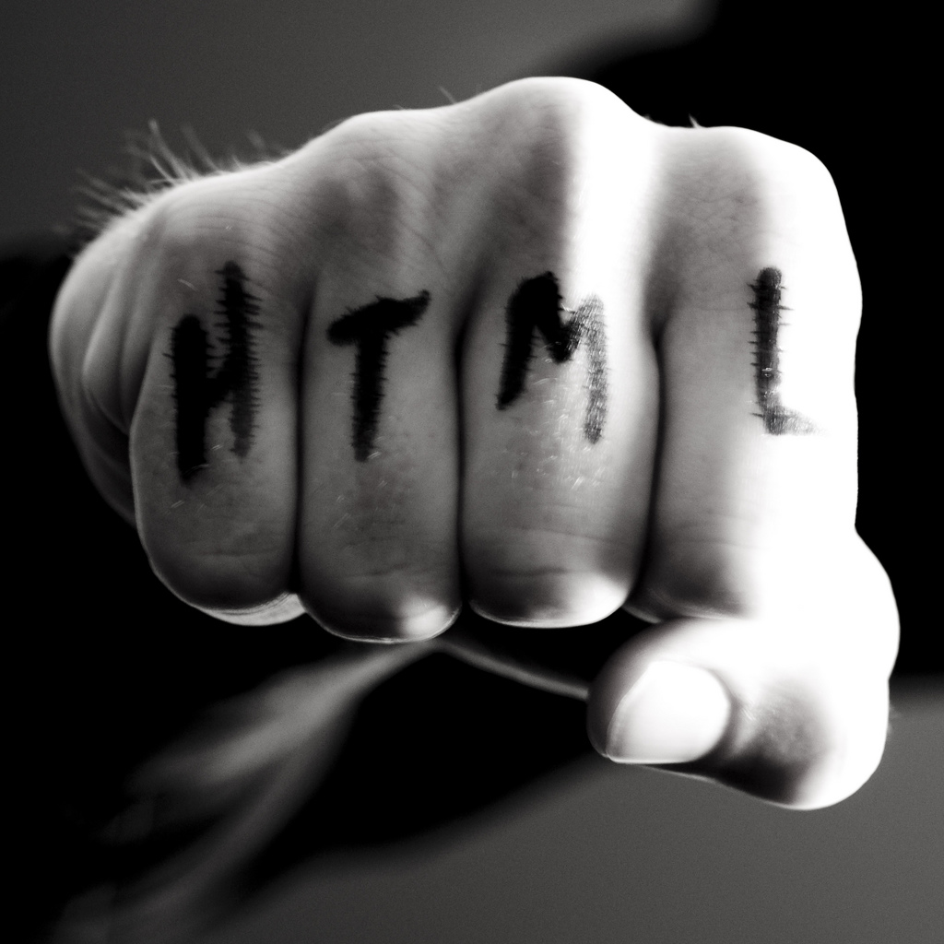
And, for a While, Web Technology was Exciting
http://www.flickr.com/photos/f-l-e-x/3096005116/

Slide 9



Browsers Competed

Slide 10
New Tools Were Released
<!DOCTYPE HTML PUBLIC "-//W3C//DTD HTML 3.2//EN">
<HTML>
<HEAD>
<TITLE>The Web, it’s pretty big</TITLE>
</HEAD>
<BODY>
<H1>From Humble Beginnings</H1>
</BODY>
</HTML>

Slide 11
And Then… Internet Explorer Won

Slide 12

And The People Who Write Web Standards Decided to Snooze
Courtesy of the Boston Public Library, Leslie Jones Collection.

Slide 13


This Created a Technology Monoculture
Notes:
13

Slide 14

(with a dash of Flash)

Slide 15
10 Years Later

Slide 16




Things changed.

Slide 17

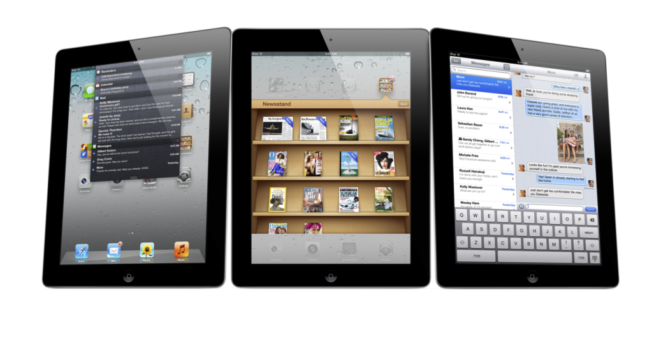
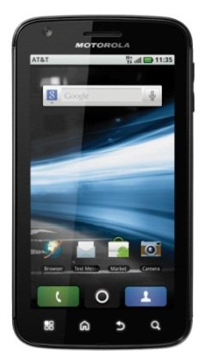
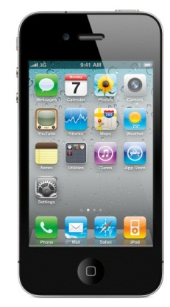
A Changing Technology Landscape
We now have a broad spectrum of devices, browsers and form factors that people are using every day. People expect to connect from anywhere, with whatever they have in hand.

Slide 18
One way to offer that connection is with HTML5
The common denominator between all these (and other web enabled devices) is a web browser. More and more of those browsers are capable of running super-cool advanced features.
That’s why we’re so excited about HTML5 and the web as a platform

Slide 19
HMTL5 and the Open Web Platform

Slide 20

So, What is HTML5?

Slide 21
It’s really two things

Slide 22

It’s a Marketing Term
"HTML5 is anything you want it to be
as long as it's new and cool.”
– Peter Paul Koch

Slide 23
That Describes The Open Web Platform
HTML5
New Semantic elements
Video and audio
Form elements and input types
Offline Web Applications
Related Technologies
SVG
Canvas
Geolocation
Web Storage
WebSocket
WebGL
EcmaScript, 5th Edition (ES5)
CSS3
2D Transforms
3D Transforms
CSS Animations
CSS Transitions
More…

Slide 24
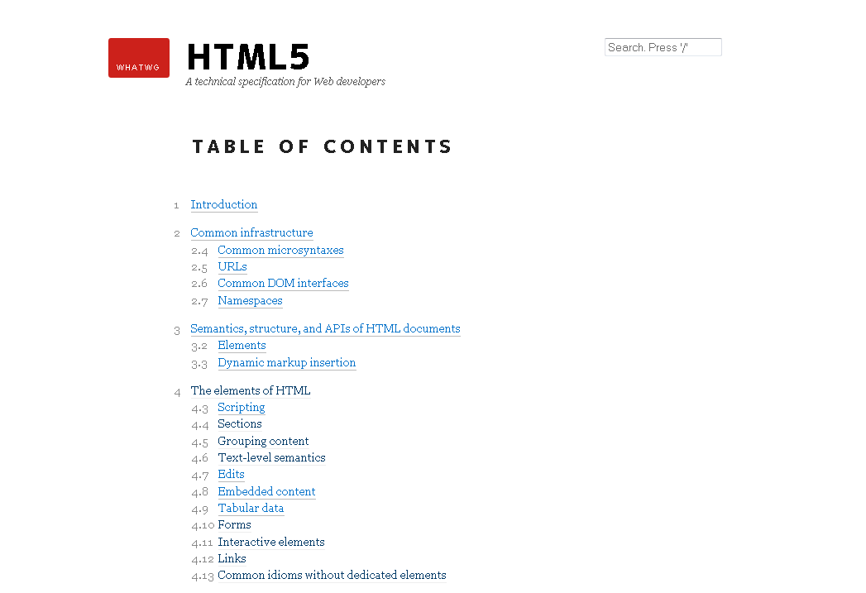
It’s Also a Specification
If you’re a developer there’s a document you can read.

Slide 25
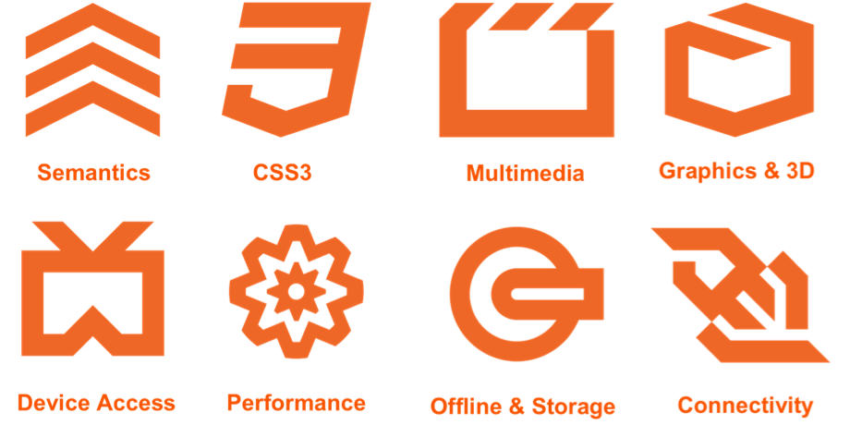
When Regular People Talk About HMTL5, they’re Talking about the Web Platform

Slide 26

Add it all up.
We have much better tools for developing and deploying rich, interactive applications over the web

Slide 27
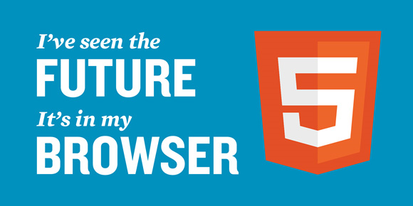

Slide 28
So, What Does the Future Look Like?

Slide 29
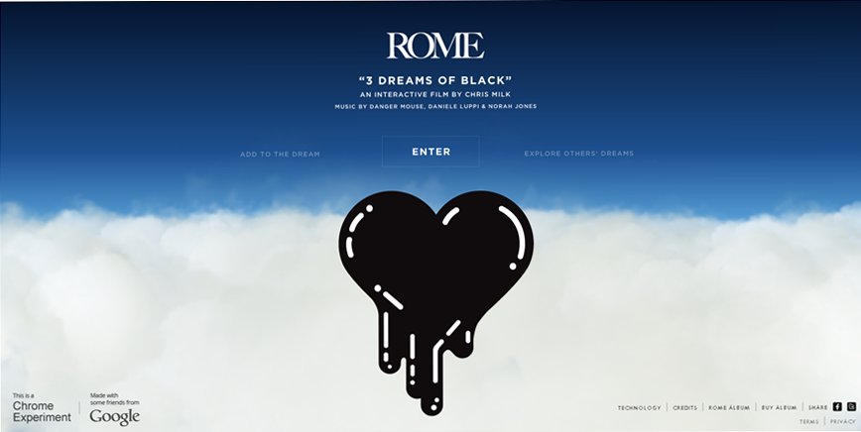
It might look a little something like this:
http://ro.me/
Notes:
I looks kind of like this... Why is this the future

Slide 30
The “Now” Is Pretty Cool

Slide 31





There are the Things You Know
Notes:
I looks kind of like this... Why is this the future

Slide 32

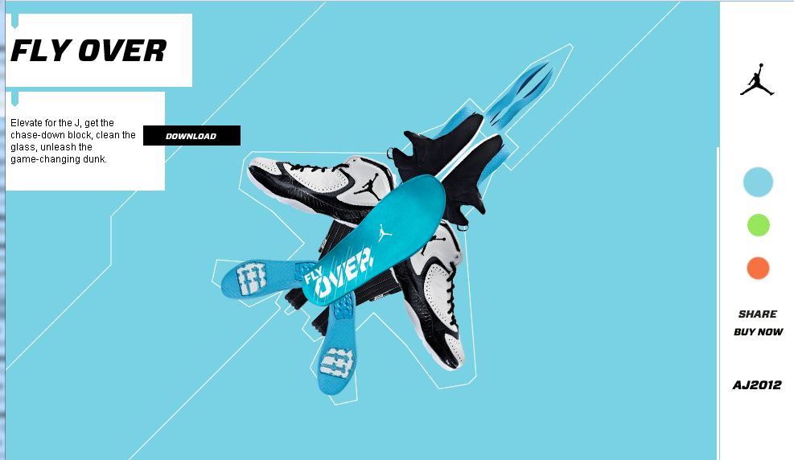
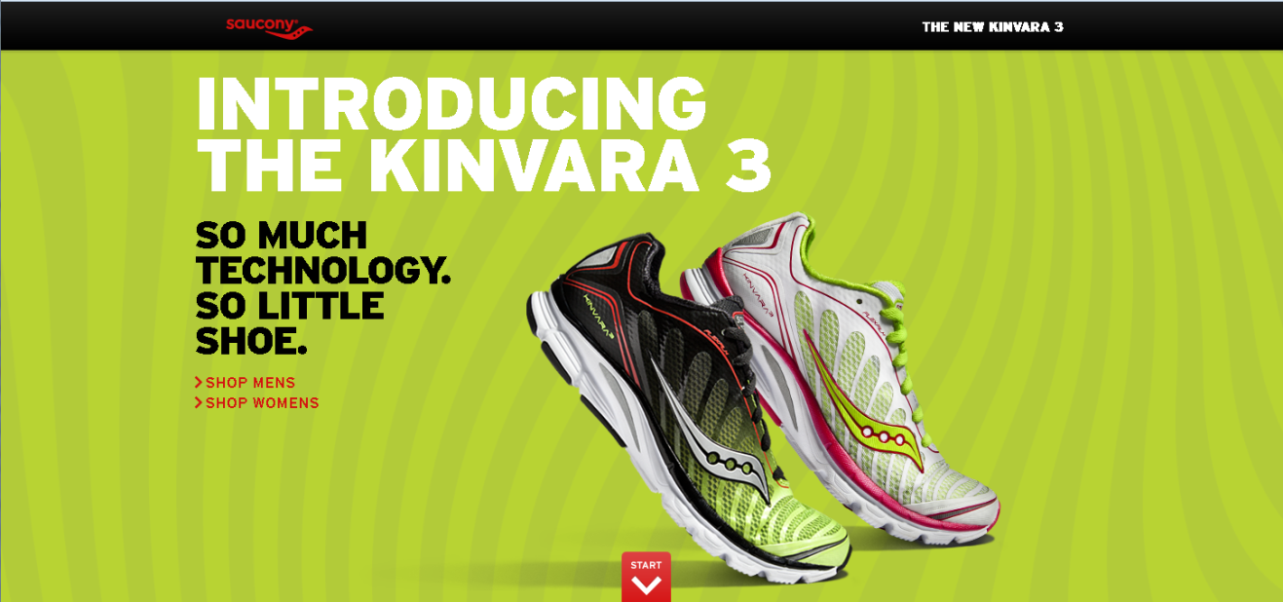
Scrolling, Parallax and Zooming sites
http://2011.beercamp.com/
http://nike.com/jumpman23/aj2012/
http://community.saucony.com/kinvara3/
Notes:
I looks kind of like this... Why is this the future

Slide 33
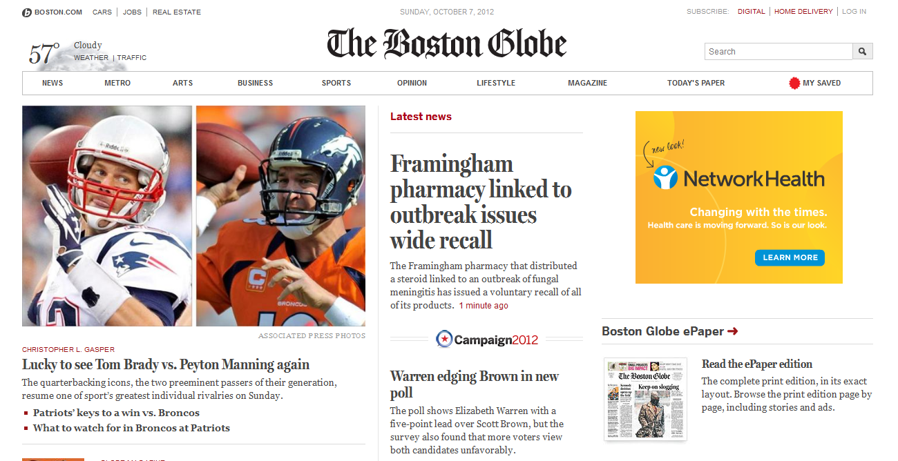
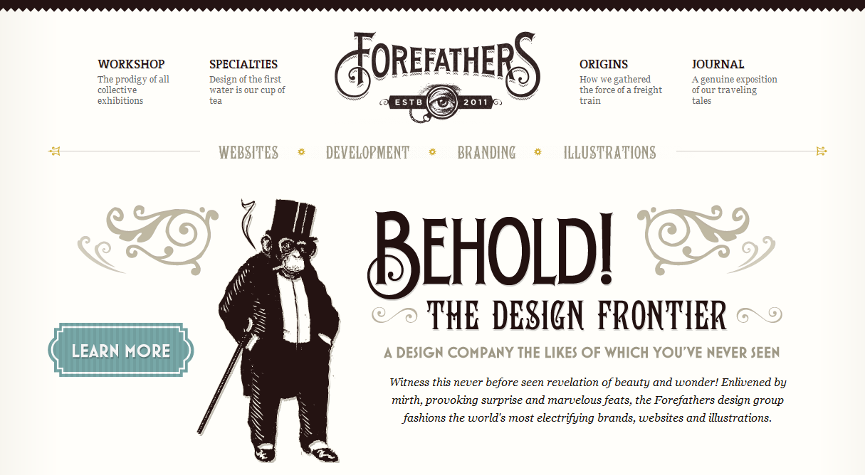
Responsive Design
http://bostonglobe.com/
http://forefathersgroup.com/
Notes:
I looks kind of like this... Why is this the future

Slide 34
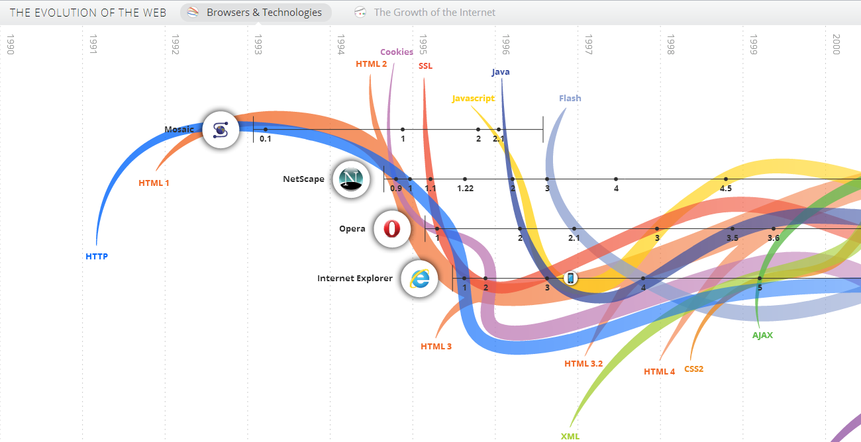
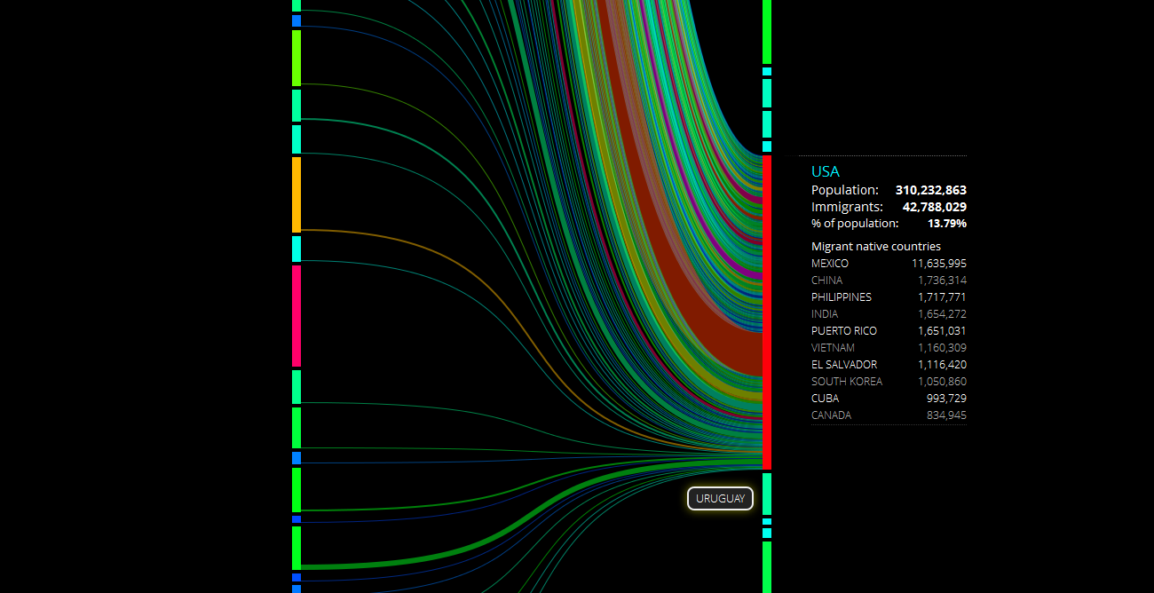
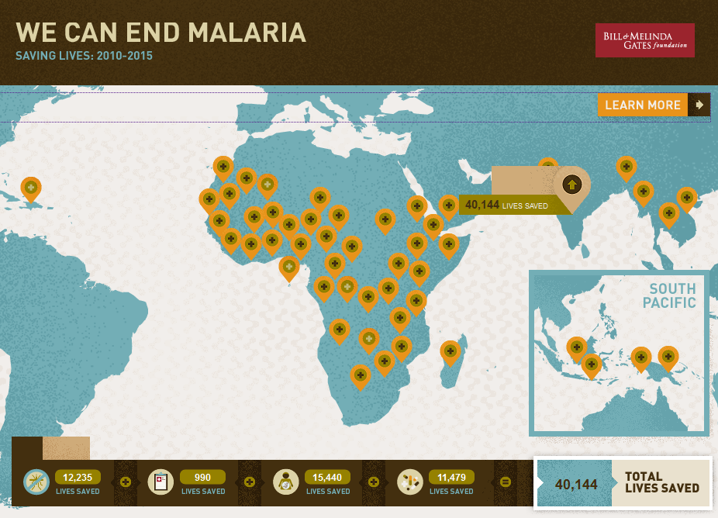
Infographics
http://evolutionofweb.appspot.com/
http://peoplemov.in/
http://www.gatesfoundation.org/infographics/documents/malaria/logo/index.html

Slide 35
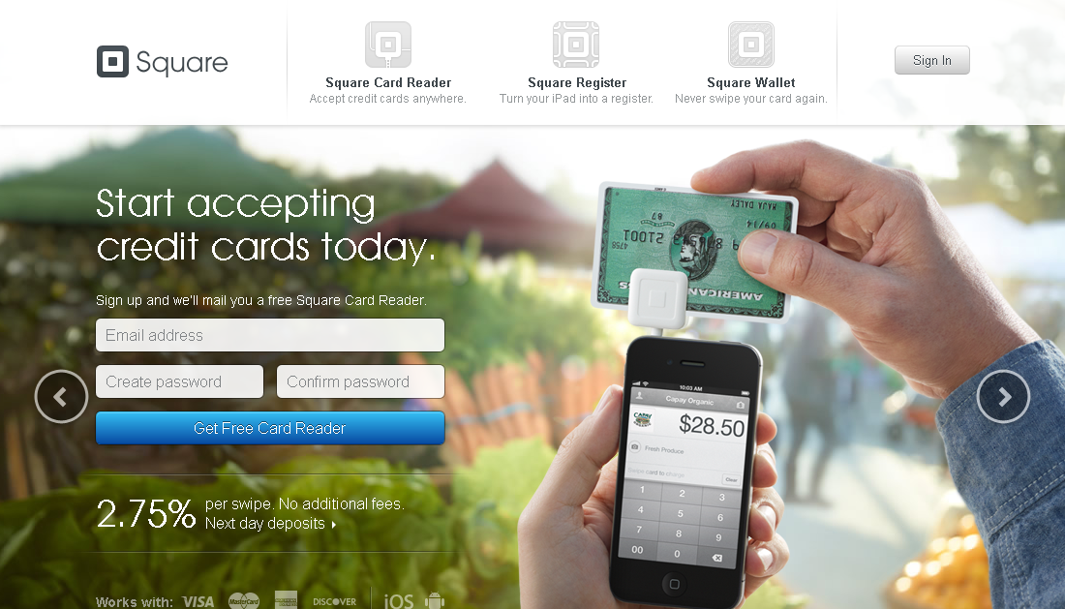
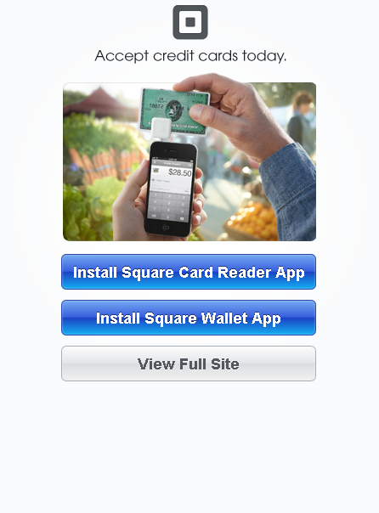
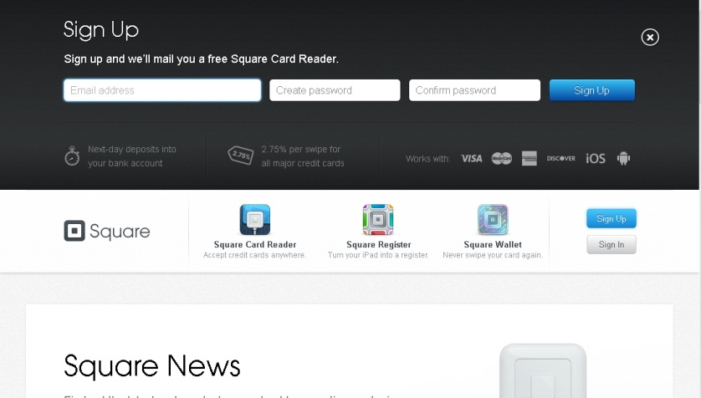
Signup and Conversion Forms

Slide 36
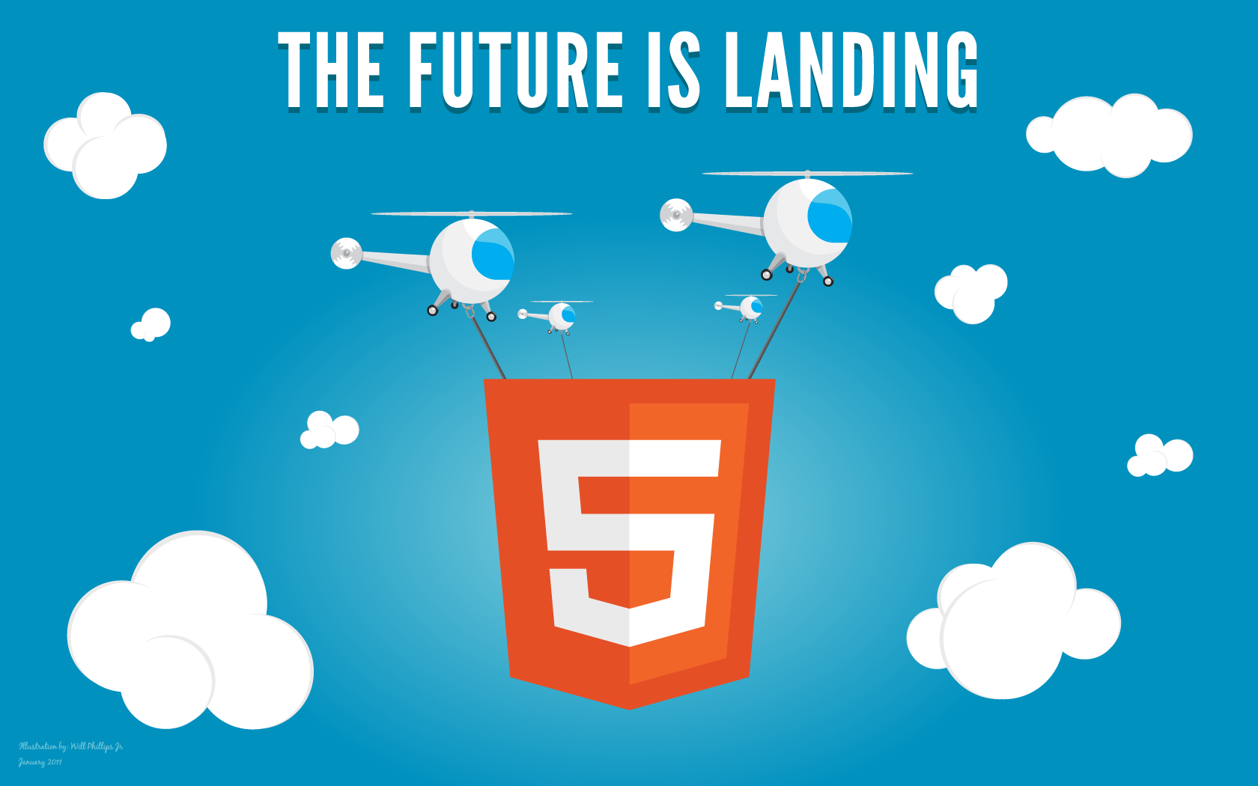

Slide 37
Thank You!

